Slide 1
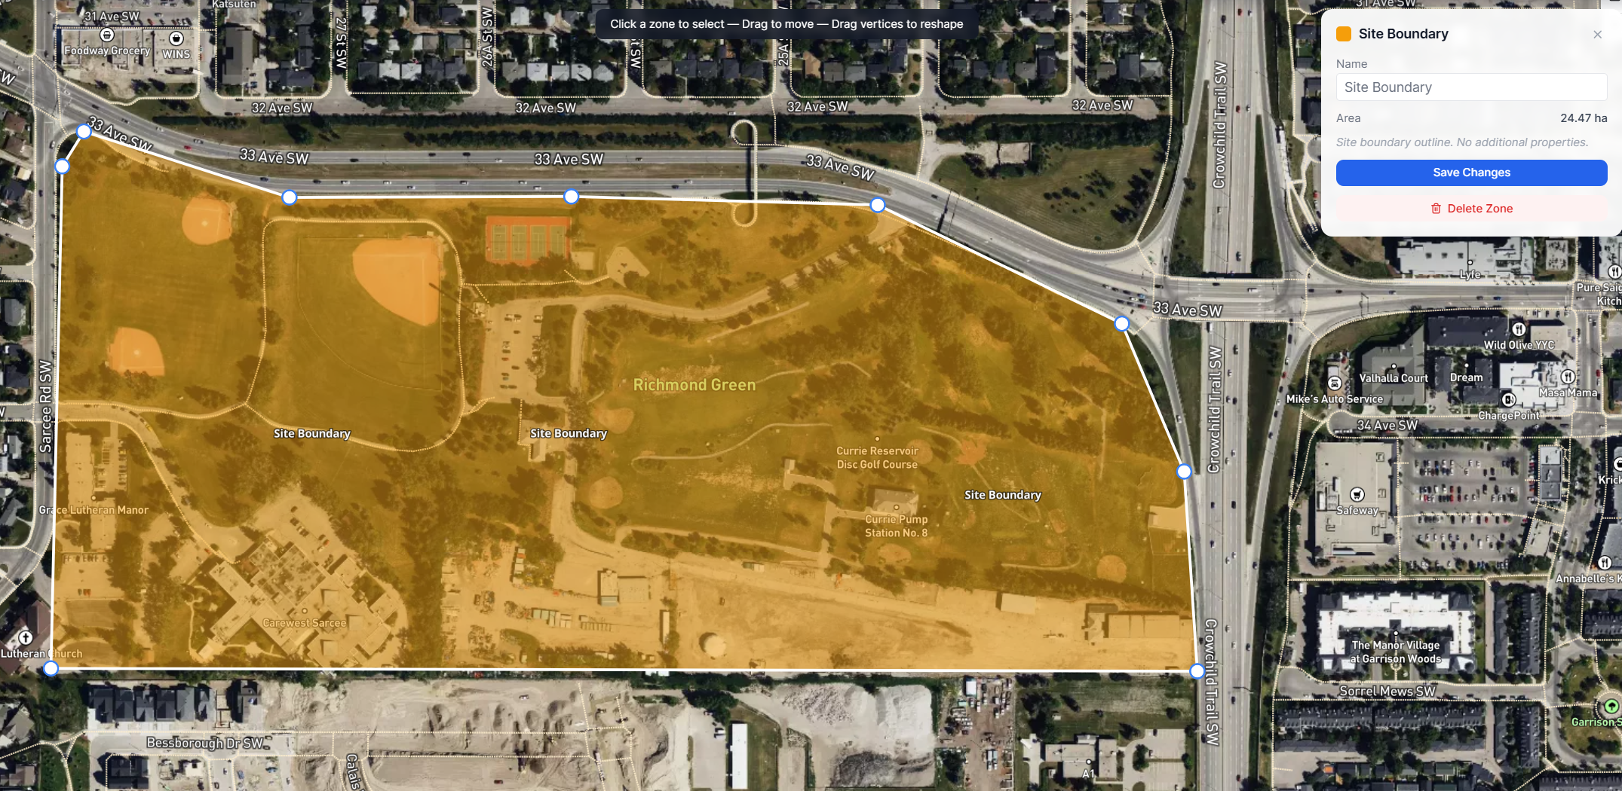
Product:
Step 1 – Define Boundary

Slide 2
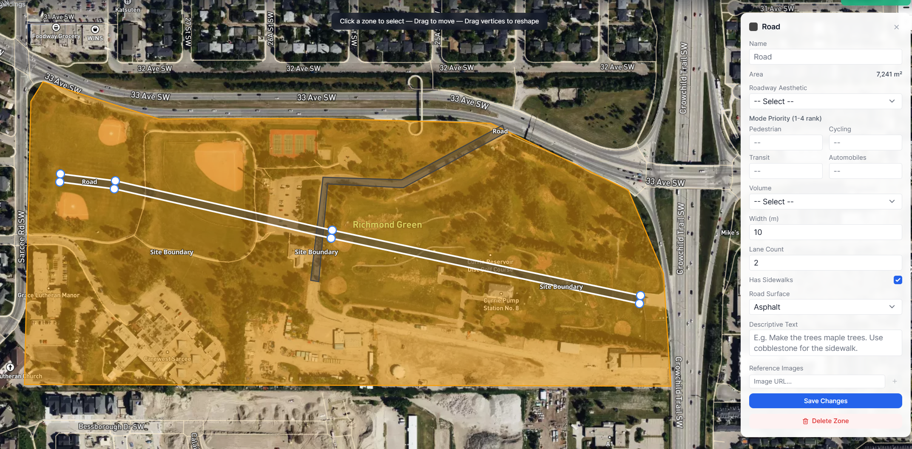
Step 2 – Create main Transportation Routes

Slide 3
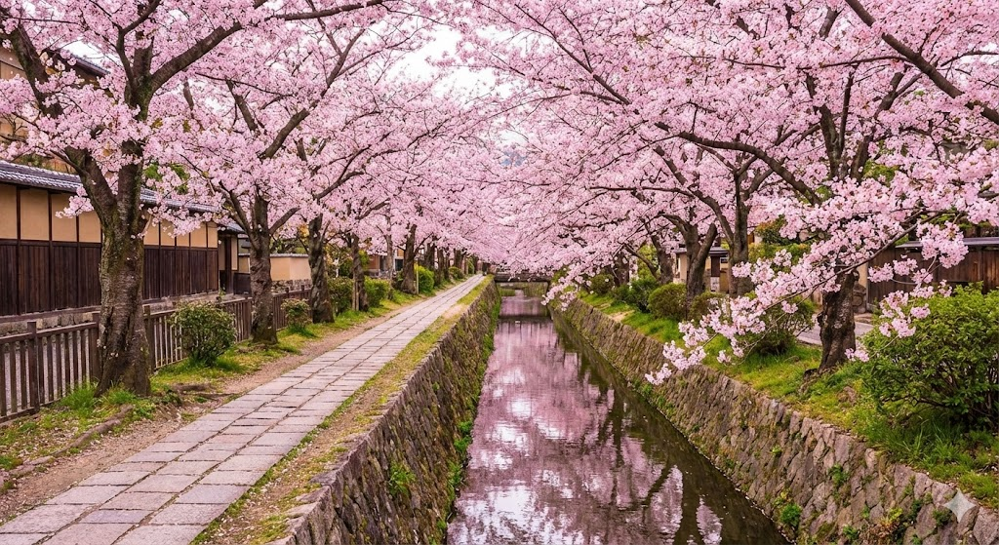
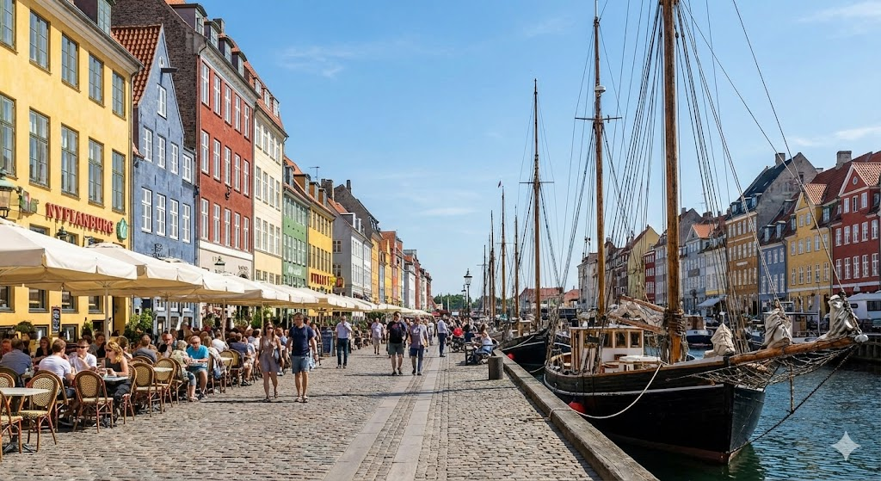
1. Draw Transportation
Create georeferenced polylines
Water-Centric Thoroughfares
2. Aesthetic
Philosopher’s Path (Kyoto, Japan)
Grand Boulevards & Avenues
Pedestrian-Focused & Scenic Streets
Water-Centric Thoroughfares
Curvilinear Residential
Neighborhood High Street
Industrial Collector
Other (add reference image or text)
Nyhavn (Copenhagen, Denmark)
3. Mode Priority
Rank 1 is top
“N/A” will not be included
Pedestrian
Cycling
Transit
Automobiles
4. Volume
High, Medium, Low
(this will determine the road size)
5. Add descriptive text
“Make the trees maple trees. Use cobblestone for the sidewalk”

Slide 4
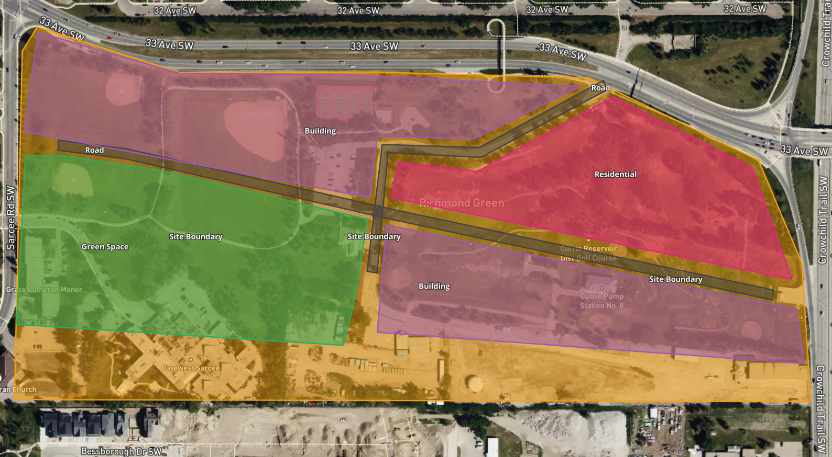
Step 3 – Parcels with generalized land use
Residential
Mixed Use (Residential and Commercial)
Green Space
Residential

Slide 5
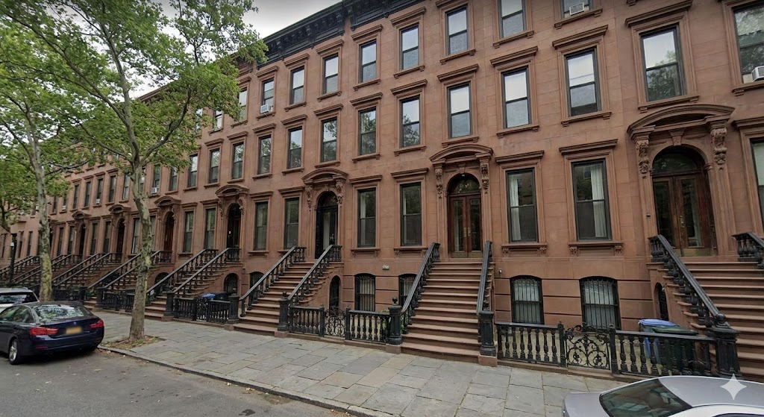
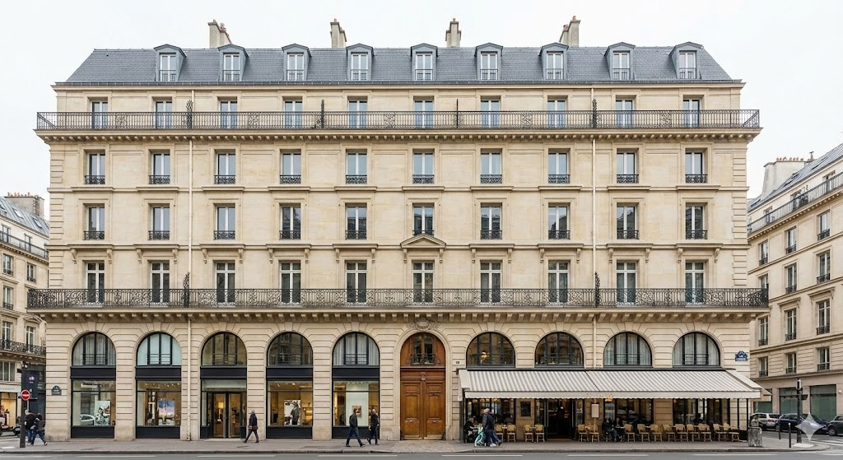
1. Draw Parcel
Create georeferenced polygon
Residential
Historic / Traditional
2. Type of Land Use
Residential
Commercial
Mixed use (residential / commercial)
Park / Plaza
Institutional (Hospital, University etc.)
Industrial
Other (add reference image or text)
New York Brownstone
3. Aesthetic
Historic / Traditional
Modern
Futuristic
Other (add reference image or text)
Parisian Haussmann Apartment
4. Building height: number of stories:
N/A (Park / Plaza), 1 (3-4m), 2 (6-8 m), 3(9-12m )…40
5. Add descriptive text
“Have the houses all have large backyards full of trees”

Slide 6
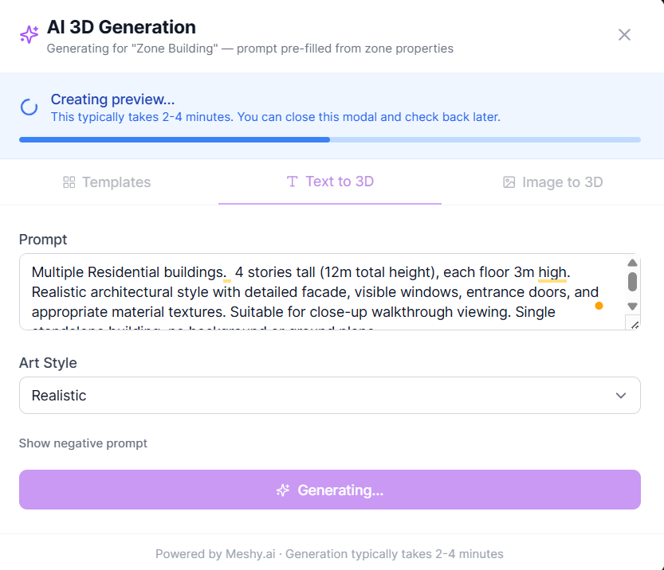
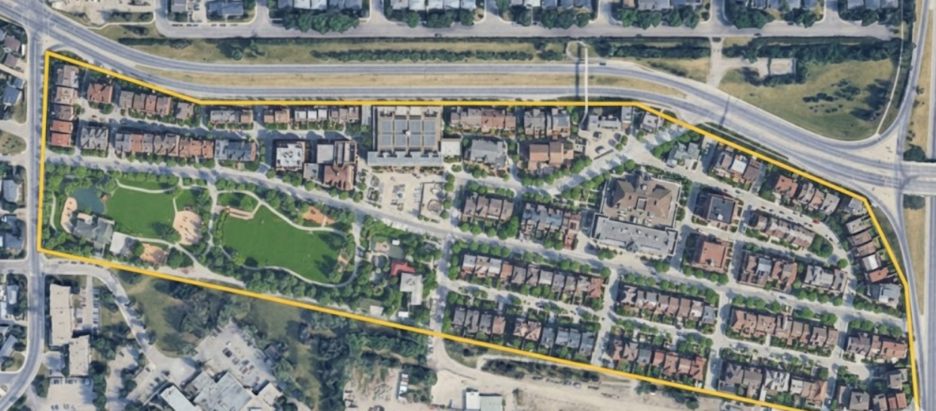
Step 4 – Generate
Everything within the site boundary (Transportation and land use) is generated.

Slide 7
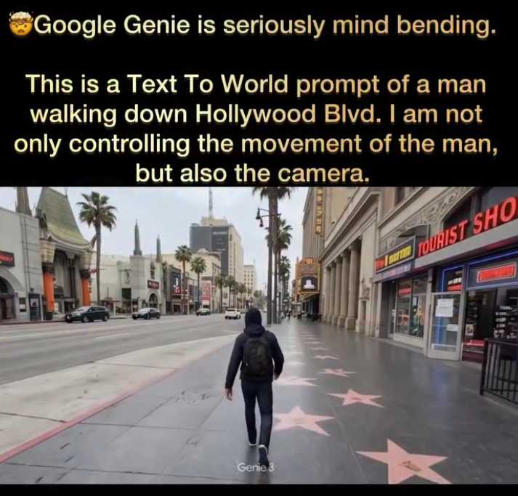
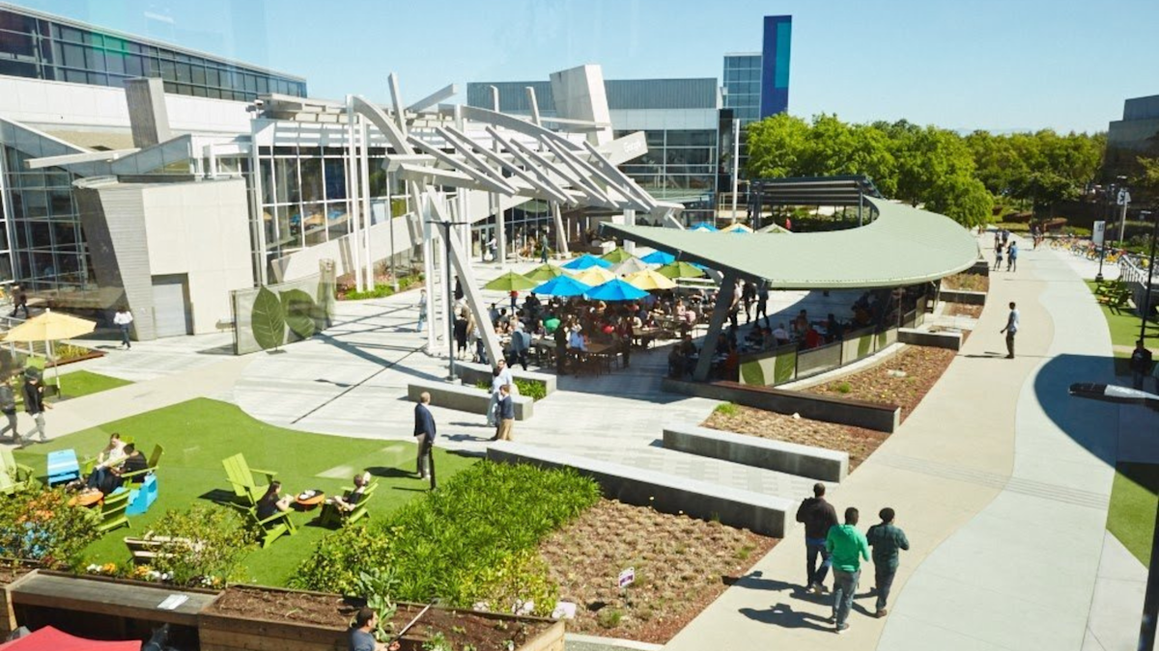

Step 5 – Digital 3D Walkthrough

Slide 8
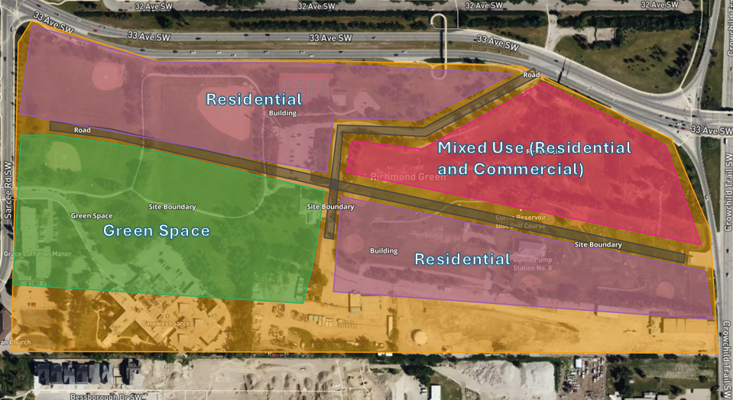
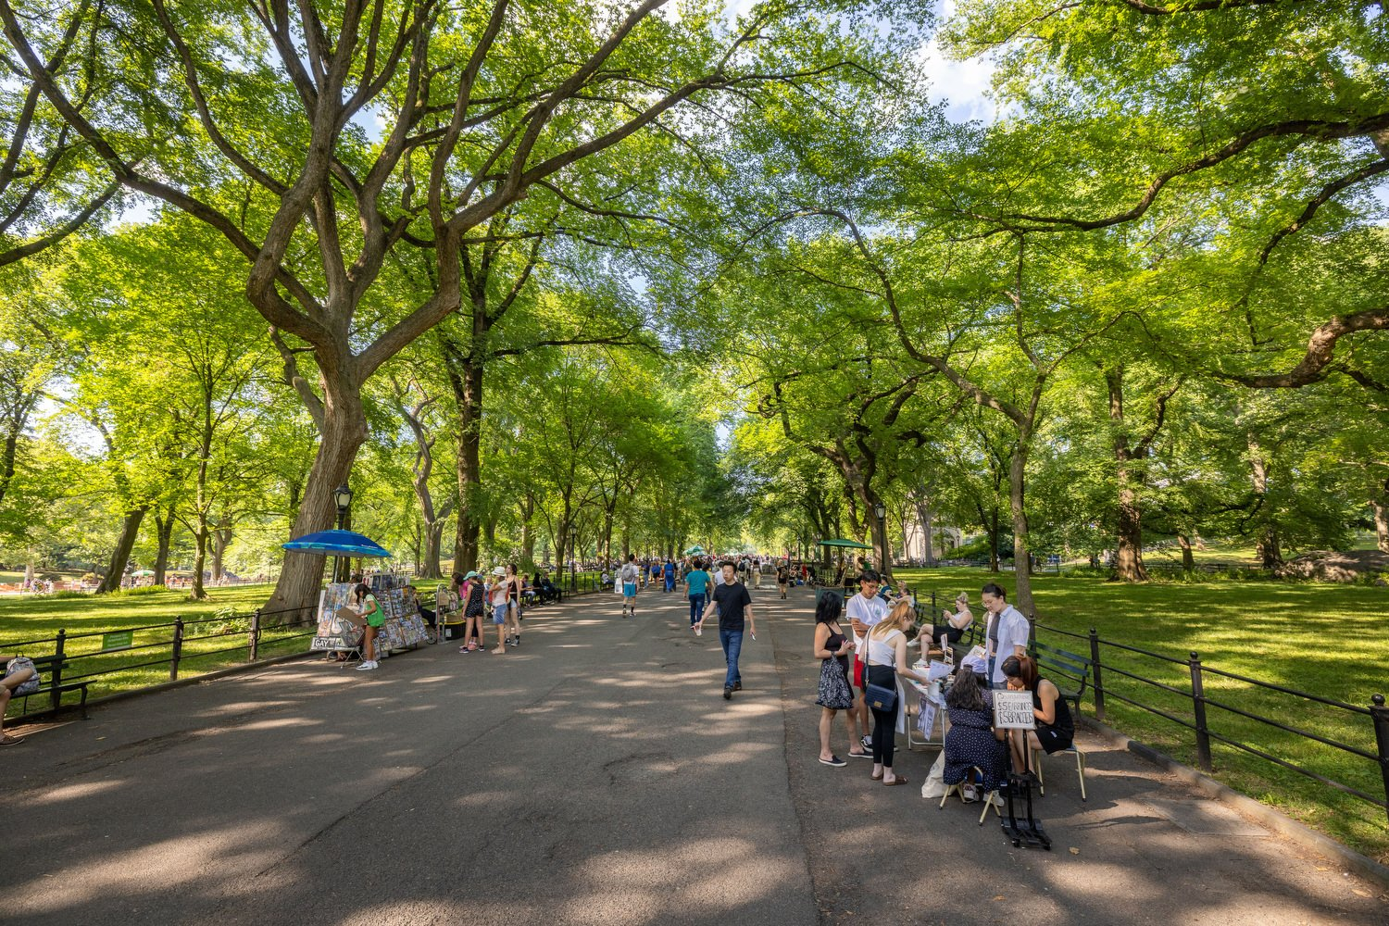
Step 5 – Digital 3D Walkthrough

Slide 9
Additional – ability to edit
Revise this intersection to be a roundabout

